Slide 1


Data Management

Slide 2
Week 12 Topics
Official (Open)
NoSQL Database
Document Database
Graph Database
Column Database
Differences between SQL and NoSQL
How to choose between SQL and NoSQL?
Redis Commands in Python

Slide 3
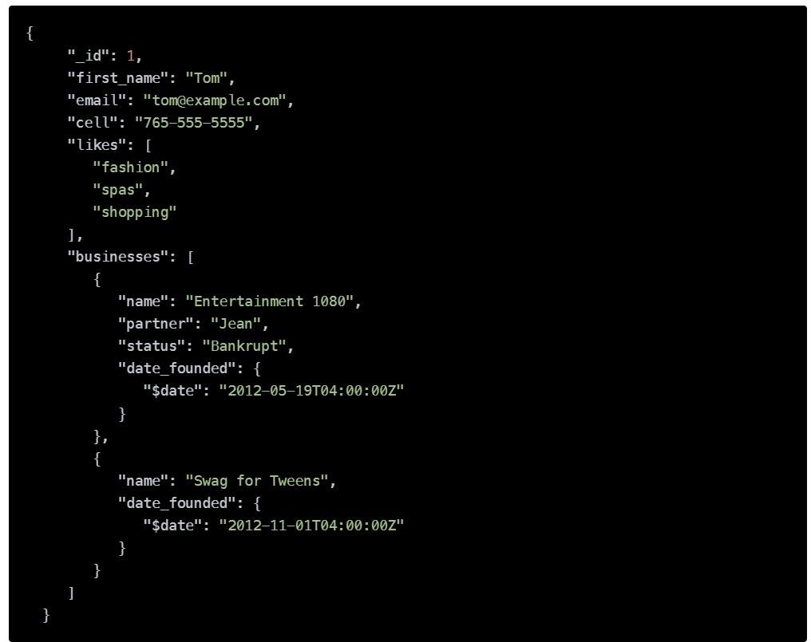

Document Database
Official (Open)
document
Document databases are similar to key-value databases in that, there’s a key and a value.
But in a document database, the value contains structured or semi-structured data (referred to as a document).
This document follows a format (json or xml)
key-value

Slide 4
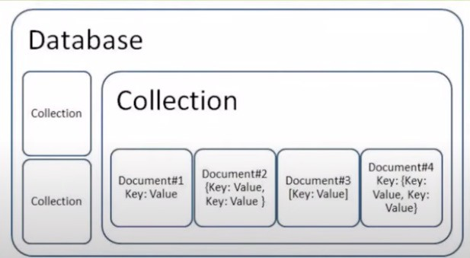

Document Database
Official (Open)
Documents are gathered together in collections within the database.
(A lot of key-value)
Doc 1
Doc 2
Doc 3
Doc 4

Slide 5



Examples of Document Database Management Systems
Official (Open)

Slide 6
Document-oriented Database Schema
Official (Open)
Consider the STUDENT relation given below.
Sql table
key
PK
SID | SFName | SPhone
16s143 | Ahmed | 91234567
16j7890 | Wafa | 90123456
value
The above STUDENT relation is represented in Document-Oriented database schema as follows:
key
value
{SID : 16s143,
SFName:”Ahmed”, Sphone: 91234567
}
{SID : 16j7890,
SFName:”Wafa”, Sphone: 90123456
}
Student_16s143 Document
Student_16j7890 Document

Slide 7
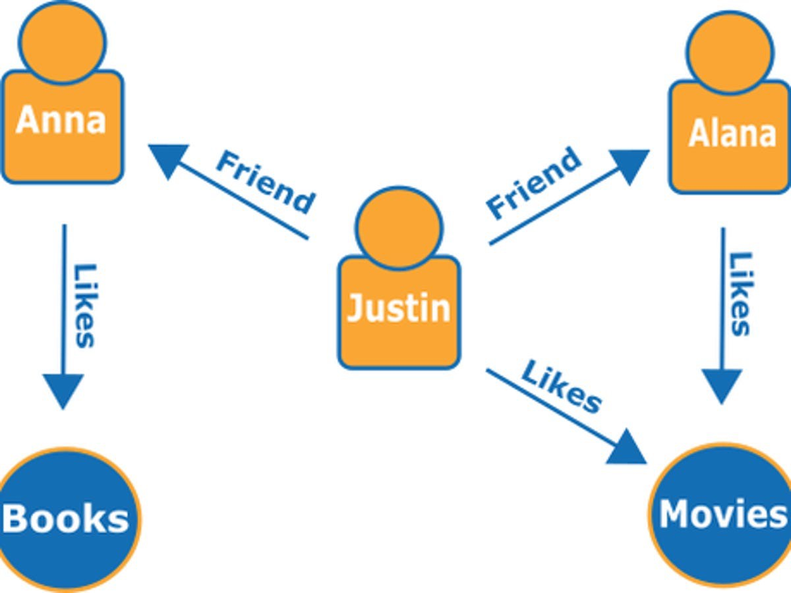
Official (Open)
An edge represents the connection or relationship between two entities.
Graph Database
Edge
Node
It organizes data in the form of a graph, to store, map and search relationships.
A graph database store data in a way that prioritizes relationships and connections.
A graph database contains a collection of nodes and edges.
edge
Node
Node
A node represents an entity.
Notes:
Study the relationship
Node is the data we want to study
Purpose: relationship
Node
edge

Slide 8



Examples of Graph Database Management Systems
Official (Open)

Slide 9
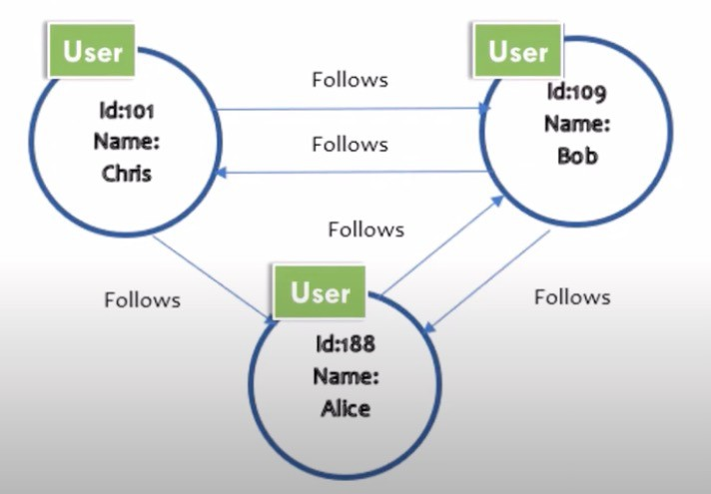
Example – Graph Database Model of users in a social media network
Official (Open)
(relationship)
Node
Node
Node
Notes:
What is the r/s between user 1 and user 2
Graph database is easier to visualize the relationship

Slide 10
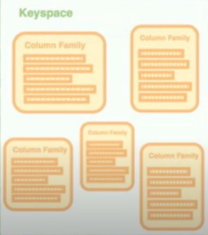
Column database
Official (Open)
Data is stored in cells grouped in columns of data rather than as rows of data.
Column database uses the concept of keyspace (like schema in relational model).
A keyspace contains column families (like tables in relational model), which contains rows, which contains columns.

Slide 11
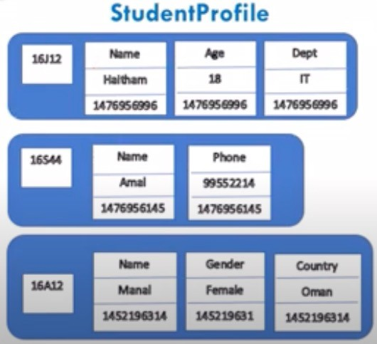
Example of a column family
Official (Open)
(Row key)
(timestamp)
This column family consists of 3 rows.
Each row contains different number of columns.
Notes:
Sql – all columns is fixed same
Nosql – columns might be diff

Slide 12
SQL
Official (Open)
NoSQL
MySQL
Oracle
Microsoft SQL Server
PostgreSQL
MongoDB
Cassandra
Redis
Neo4j

Slide 13
Differences between SQL and NoSQL
Official (Open)
(various)
 | SQL | NoSQL
Data Storage Model | Tables with fixed rows and columns | Document: JSON documents, Key- value: key-value pairs, Wide-column: tables with rows and dynamic columns, Graph: nodes and edges
Primary Purpose | General purpose | Document: general purpose, Key-value: large amounts of data with simple lookup queries Wide-column: large amounts of data with predictable query patterns Graph: analyzing and traversing relationships between connected data
Notes:
Very fast, not complicated – use key value pair

Slide 14
Differences between SQL and NoSQL
Official (Open)
 | SQL | NoSQL
Schemas | Rigid | Flexible
Scaling | Vertical (scale-up with a larger server) | Horizontal (scale-out across commodity servers)
Joins | Typically required | Typically not required
Language | SQL | Not locked into one language.
Notes:
Server side by side – horizontal
Serve on top of each other - vertical

Slide 15
How to choose between SQL and NoSQL?
Official (Open)
Consider SQL databases when… | Consider NoSQL databases when…
Your data is highly structured, and that structure doesn’t change frequently You require a high degree of data integrity and security You routinely perform complex queries | You are working with large amounts of unstructured or semi-structured data You require a database system that can be scaled horizontally, perhaps across multiple geographic locations You require the flexibility of a dynamic schema
Notes:
If data change a lot – consider Nosql

Slide 16

Redis
Official (Open)
Features:
Holds its database entirely in memory
Exceptionally fast
Supports rich data types
Typically used in caching, such as web application sessions

Slide 17
Redis Key Commands
Official (Open)
Command | Description
r.delete(“key”) | This command deletes the key, if it exists.
r.exists(“key”) | This command checks whether the key exists or not.
r.expire(“key”, seconds) | Sets the expiry of the key after the specified time.
r.setex(“key”, seconds, ”value”) | Sets the key-value with expiry in seconds.
r.pexpire(“key”, seconds) | Set the expiry of key in milliseconds.
r.ttl(“key”) | Gets the remaining time in keys expiry.
r.pttl(“key”) | Gets the remaining time in keys expiry in milliseconds.
r.randomkey() | Returns a random key from Redis.
r.rename(“key”, “newkey”) | Changes the key name.
r.type(“key”) | Returns the data type of the value stored in the key.
Notes:
In python (test)

Slide 18
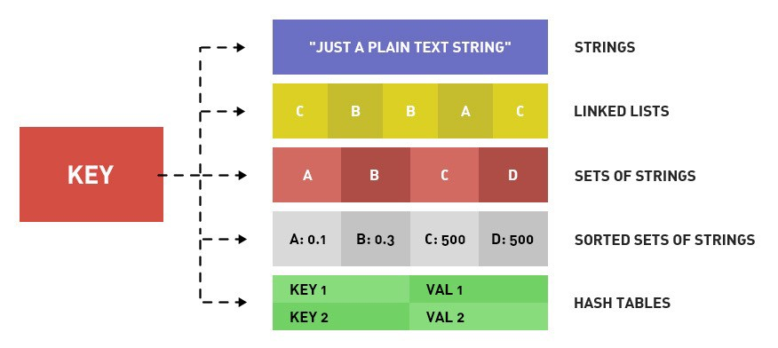
Redis Data Types
Official (Open)
Notes:
String – one key one value
Need to know need to know how to tell the diff
Test - will test the datatypes and how to use those

Slide 19
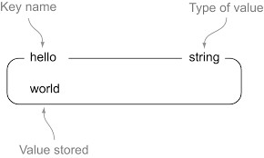
String
Official (Open)

Slide 20
String Commands
Official (Open)
Command | Description
r.set(“key”, “value”) | This command sets the value at the specified key.
r.get(“key”) | Gets the value of a key.
r.getrange(“key”, start, end) | Gets a substring of the string stored at a key.
r.getset(“key”, “value”) | Sets the string value of a key and return its old value.
r.mset({“key1”: “value1”, “key2”: “value2”}) | Sets multiple keys to multiple values
r.mget(“key1”, “key2”, “key3”) | Gets the values of all the given keys
r.strlen(“key”) | Gets the length of the value stored in a key
r.incr(“key”) | Increments the integer value of a key by one
r.decr(“key”) | Decrements the integer value of a key by one

Slide 21
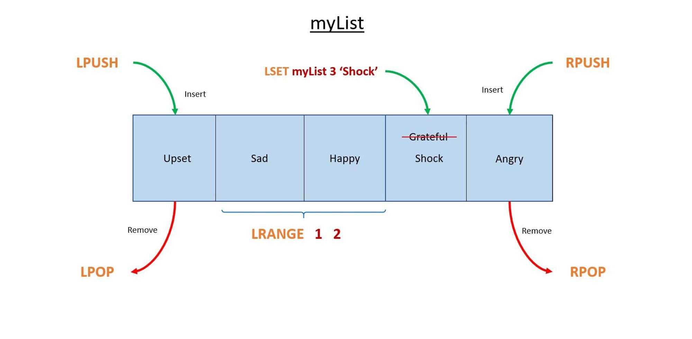
Linked List / List
Official (Open)

Slide 22
Linked List/List Commands
Official (Open)
Command | Description
r.lindex(“key”, index) | Gets an element from a list by its index
r.llen(“key”) | Gets the length of a list
r.lpop(“key”) | Removes and gets the first element in a list
r.lpush(“key”, value) | Prepends one or multiple values to a list
r.lrange(“key”, start, stop) | Gets a range of elements from a list
r.rpop(“key”) | Removes and gets the last element in a list
r.rpush(“key”, value) | Appends one or multiple values to a list
r.lset(“key”, index, value) | Sets the value of an element in a list by its index
r.ltrim(“key”, start, stop) | Trims a list to the specified range

Slide 23
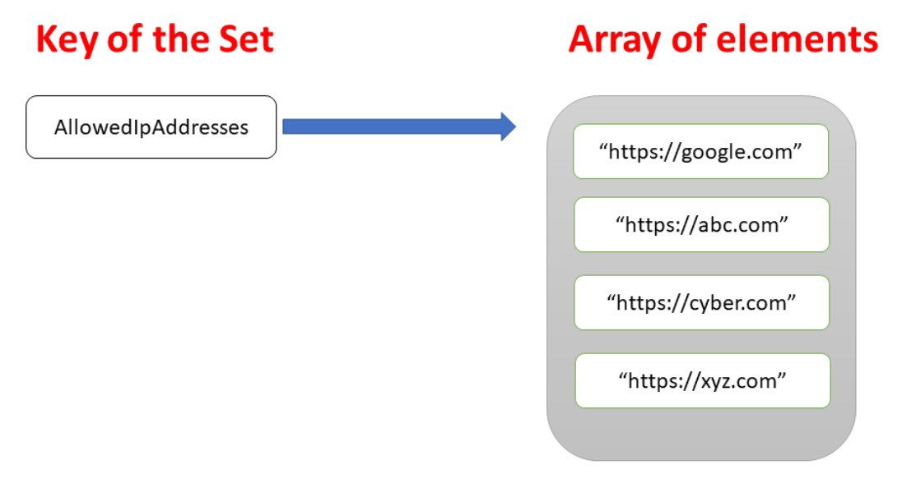
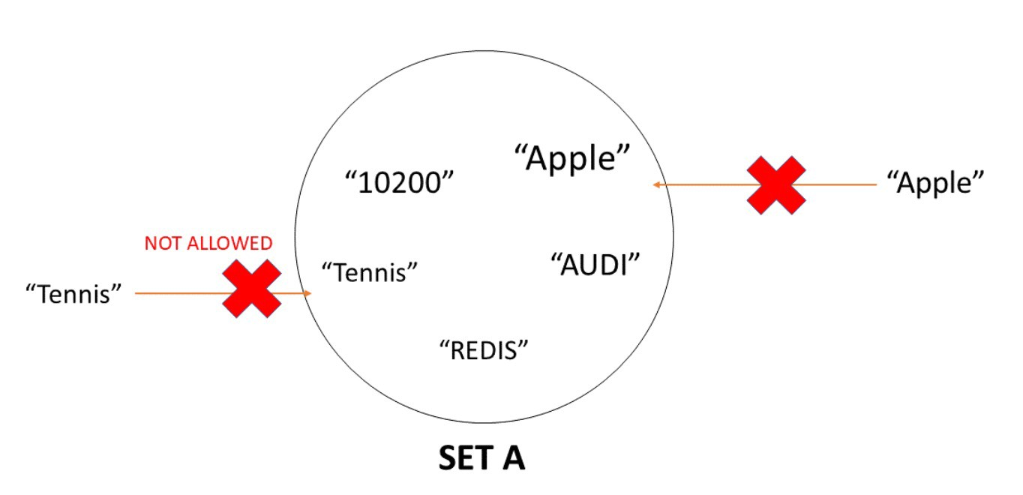
Sets
Official (Open)

Slide 24
Sets Commands
Official (Open)
Command | Description
r.sadd(“key”, member1, member2…) | Adds one or more members to a set
r.scard(“key”) | Gets the number of members in a set
r.sismember(“key”, member) | Determines if a given value is a member of a set
r.smembers(“key”) | Gets all the members in a set
r.sunion(“key1”, “key2”) | Adds multiple sets
r.spop(“key”) | Removes and returns a random member from a set
r.srem(“key”, member1, member2…) | Removes one or more members from a set

Slide 25
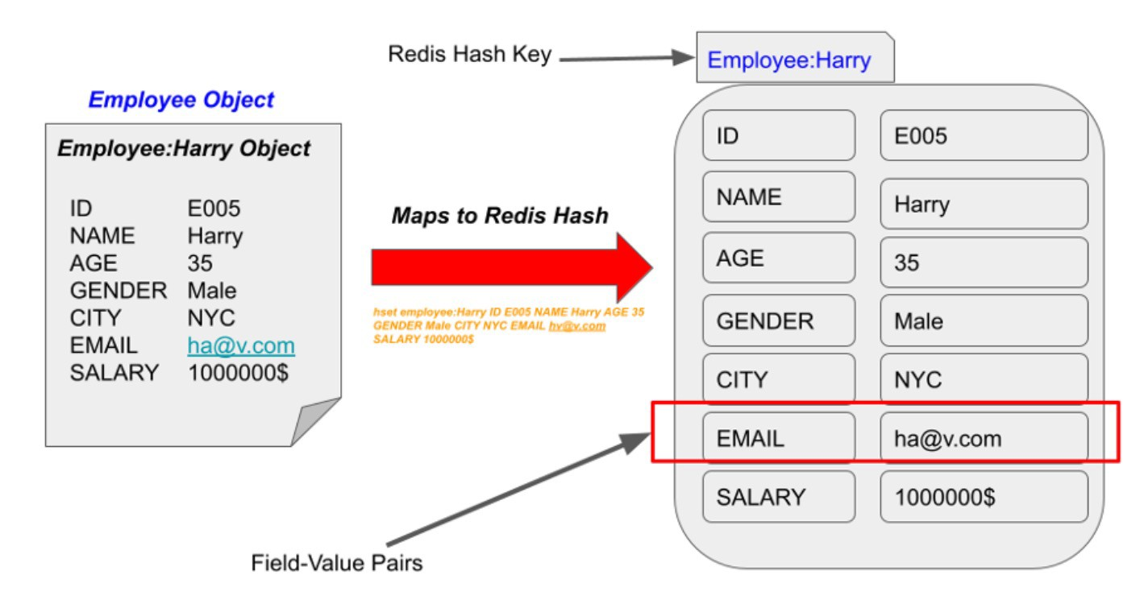
Hash
Official (Open)

Slide 26
Hash Commands
Official (Open)
Command | Description
r.hdel(“key”, “field1”, “field2”…) | Deletes one or more hash fields.
r.hexists(“key”, “field”) | Determines whether a hash field exists or not.
r.hset(“key”, “field”, value) | Sets the string value of a hash field
r.hget(“key”, “field”) | Gets the value of a hash field stored at the specified key.
r.hgetall(“key”) | Gets all the fields and values stored in a hash at the specified key
r.hkeys(“key”) | Gets all the fields in a hash
r.hlen(“key”) | Gets the number of fields in a hash
r.hmset(“key”, {“field1”: “value1”, “field2” : “value2”}) | Sets multiple hash fields to multiple values
r.hmget(“key”, “field1”, “field2”…) | Gets the values of all the given hash fields
r.hincrby(“key”, “field”, increment) | Increments the integer value of a hash field by the given number

Slide 27
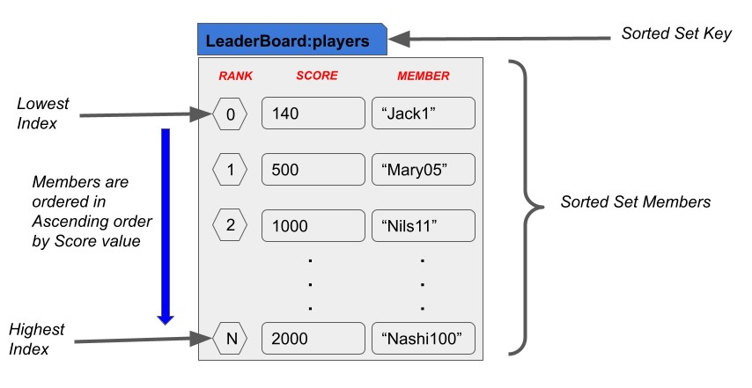
Sorted Sets
Official (Open)

Slide 28
Sorted Sets Command
Official (Open)
Command | Description
r.zadd(“key”, {“member1”:score1, “member2”: score2}) | Adds one or more members to a sorted set.
r.zcard(“key”) | Gets the number of members in a sorted set
r.zcount(“key”, min max) | Counts the members in a sorted set with scores within the given values
r.zincrby(“key”, increment, “member”) | Increments the score of a member in a sorted set
r.zrem(“key”, “member1”, “member2”...) | Removes one or more members from a sorted set
r.zremrangebyscore(“key”, min, max) | Removes all members in a sorted set within the given scores
r.zremrangebyrank(“key”, start, stop) | Removes all members in a sorted set within the given indexes

Slide 29
Sorted Sets Command
Official (Open)
Command | Description
r.zrank(“key”, “member”) | Determines the index of a member in a sorted set
r.zrevrank(“key”, “member”) | Determines the index of a member in a sorted set, with scores ordered from high to low
r.zrange(“key”, start, stop, withscores=True/False) | Returns a range of members in a sorted set, by index
r.zevrange(“key”, start, stop, withscores=True/False) | Returns a range of members in a sorted set, by index, with scores ordered from high to low
r.zrangebyscore(“key”, min, max, withscores=True/False) | Returns a range of members in a sorted set, by score
r.zrevrangebyscore(“key”, max, min, withscores=True/False) | Returns a range of members in a sorted set, by score, with scores ordered from high to low
r.zscore(“key”, “member”) | Gets the score associated with the given member in a sorted set

